Slide 1

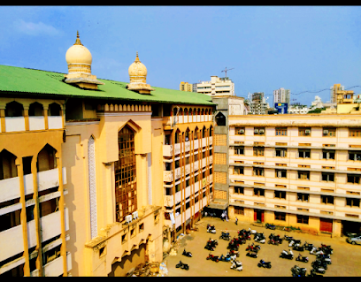
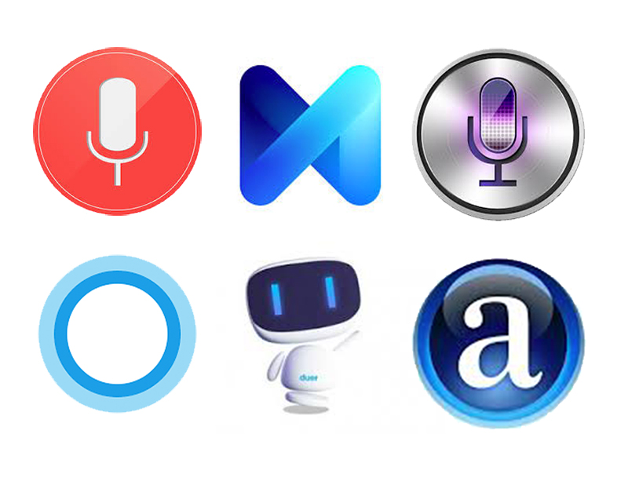
Mini Project Sem III
M.H. SABOO SIDDIK COLLEGE OF ENGINEERING
Anjuman-I-Islam’s
Desktop Virtual Voice Assistant using Python
COMPUTER ENGINEERING
A.Y. 2021-22

Slide 2

GROUP MEMBERS:
M.H. SABOO SIDDIK COLLEGE OF ENGINEERING
Anjuman-I-Islam’s
BHABAL ROHAN RAVINDRA (312010)
BIJAPUR AZIM AHMED MUKTAR AHMED (312011)
KHAN ARKAAN FAIZAD (312021)
SHAIKH ABUZAR HAFIZUDDIN (312041)

Slide 3
Introduction:
M.H. SABOO SIDDIK COLLEGE OF ENGINEERING
Anjuman-I-Islam’s
In this project we have designed a desktop virtual voice assistant using python and its modules.
We have named it Alex
User is expected to just give a voice command and the assistant will execute those tasks.
The application uses the microphone as the source.
Mainly we can classify these commands into three types: web related, system related and questions.
We have aimed to automate nearly all the day to day life tasks .The application does not use AI and Machine Learning algorithms.

Slide 4

Motivation:
M.H. SABOO SIDDIK COLLEGE OF ENGINEERING
Anjuman-I-Islam’s
Dark sides of voice assistant in the market like Google assistant, Alexa etc.
More secure alternative
It will help the user to access nearly each and every useful file and application in the system .
So this program is capable of functioning without internet connectivity for queries related to the system
Platform independent

Slide 5

Capabilities:
M.H. SABOO SIDDIK COLLEGE OF ENGINEERING
Anjuman-I-Islam’s
• Sending emails
• Playing music
• Opening code editors
• Opening MS Office applications
• Opening YouTube
• Opening folders
• Opening Google
• Searching on Wikipedia
• Getting the weather news

Slide 6
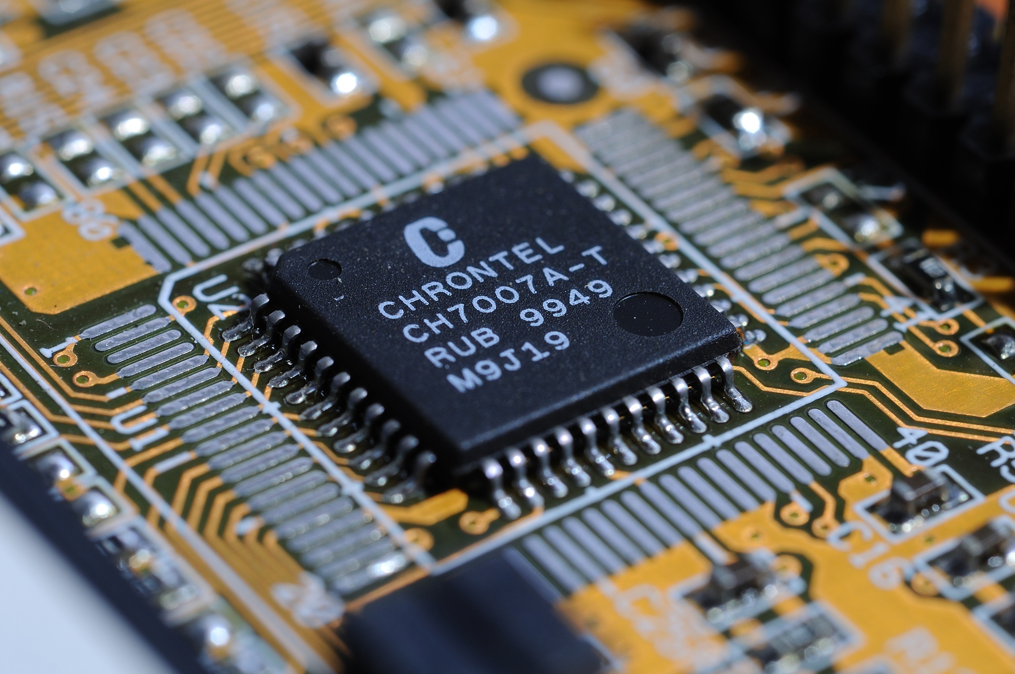
Hardware Requirements:
M.H. SABOO SIDDIK COLLEGE OF ENGINEERING
Anjuman-I-Islam’s
➢ x86 64-bit CPU (Intel / AMD architecture)
➢ 4GB RAM
➢ 5 GB Disk Space

Slide 7
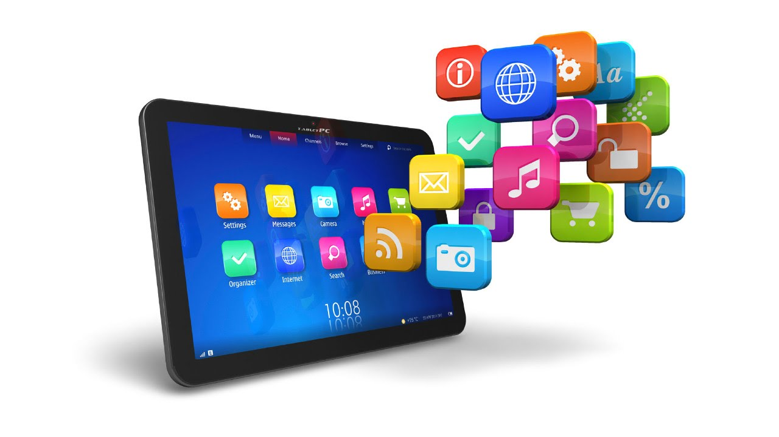
Software Requirements:
M.H. SABOO SIDDIK COLLEGE OF ENGINEERING
Anjuman-I-Islam’s
➢ Windows 7 or 10
➢ Mac OS X 10.11 or higher 5
➢ Linux: RHEL 6/7
➢ Python 3.10.0 ➢ Visual Studio Code (IDE)
➢ Important Python Modules like:

Slide 8
M.H. SABOO SIDDIK COLLEGE OF ENGINEERING
Anjuman-I-Islam’s
pyttsx3 (converts text to speech)
sapi5 (software development kit by Microsoft )
speech recognition (converts speech to text )
Wikipedia (to access Wikipedia and search queries on it)
OS (to interact with the operating system)
Smtp lib (to send emails)
datetime(to get the current time )
Web browser (to access other websites)

Slide 9
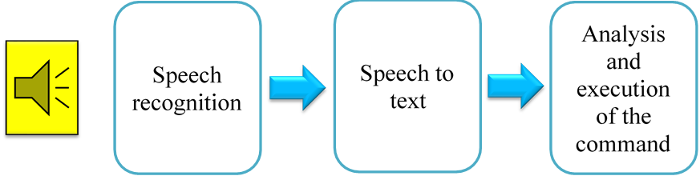
System design and working:
M.H. SABOO SIDDIK COLLEGE OF ENGINEERING
Anjuman-I-Islam’s

Slide 10
System design and working:
M.H. SABOO SIDDIK COLLEGE OF ENGINEERING
Anjuman-I-Islam’s
takecommand() function: which makes use of Speech Recognition module to recognize the speech and convert it into a query string.
This query is then fed to other functions which then execute the commands
To enable the application take commands, we put all the functions (used else if for each) in an infinite while loop
speak() function :In order to make it speak something we must give it a text. This text is then converted to speech using pyttsx3 module. pyttsx3 engine is capable of converting text to speech and a say() function in it helps to speak whatever is being fed to it.
voices for our program is given by a software development kit developed by Microsoft called ‘sapi5’ which uses system voices for the purpose.

Slide 11
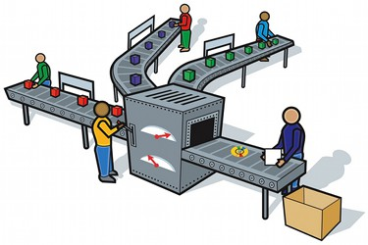
Algorithm and Process Design:
M.H. SABOO SIDDIK COLLEGE OF ENGINEERING
Anjuman-I-Islam’s
Start
Wait for a query from user
If
questions
command
quit
Execute the command
Good Bye
Execute query
End

Slide 12
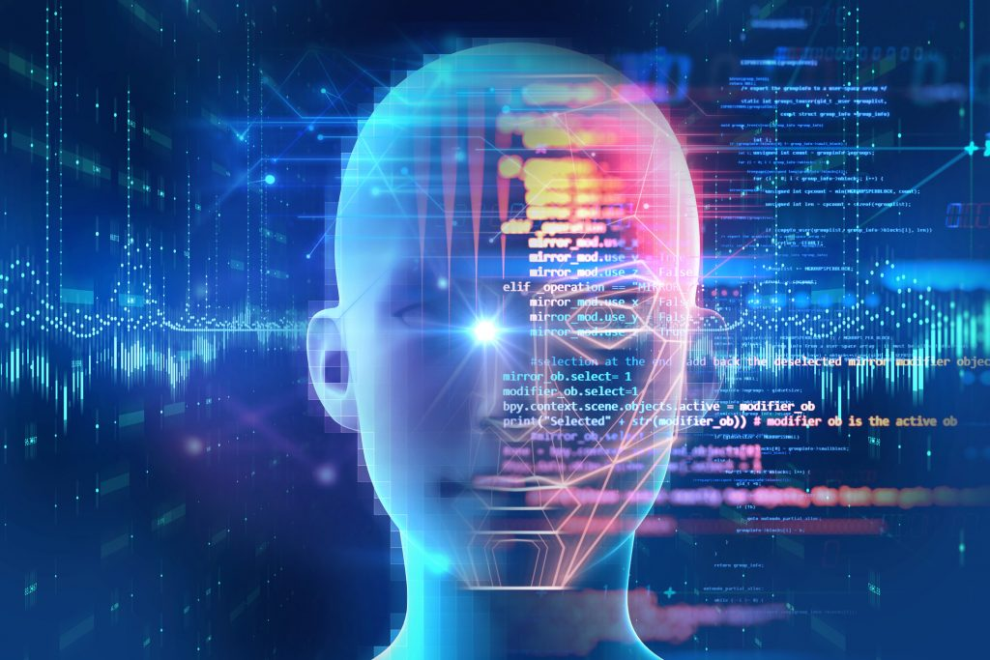
Future Scope:
M.H. SABOO SIDDIK COLLEGE OF ENGINEERING
Anjuman-I-Islam’s
What we have at the present is only a program that when run from the IDE would become our voice assistant.
So in the future one may add some GUI
runnable file using ‘pyinstaller’

Slide 13
Conclusion:
M.H. SABOO SIDDIK COLLEGE OF ENGINEERING
Anjuman-I-Islam’s
In this project we have presented the design and implementation of a virtual desktop assistant “Alex” which will be programmed merely using python. Using this application, we will be able to automate our desktop, access some important sites on the web and also ask queries to the assistant which it will answer referring to the Wikipedia. In short, this assistant will help us in being more productive at work and save time.

Slide 14

References:
M.H. SABOO SIDDIK COLLEGE OF ENGINEERING
Anjuman-I-Islam’s
Code with Harry – YouTube (https://www.youtube.com/channel/UCeVMnSShP_Iviwkknt83cww )
https://extrudesign.com/virtual-assistant-using-python/
Ravikumar , Prateek , Sathvik Bhandar, Rahul Kumar, Mayura D Tapkire “virtual voice assistant”,International Research Journal of Engineering and Technology(2020)
Python docs (https://www.python.org/doc/ )

Slide 15
THANK YOU

